Slide 1
Deep learning for medical image in super-resolution reconstruction
Meili Liu

Slide 2
Deep learning for medical image
Image acquisition and reconstruction
Image enhancement, including Denoising, Super-resolution
Detection, Localization and Segmentation
Analysis of shape and texture
Diagnosis and Prediction
Notes:
Topics. Magliant

Slide 3
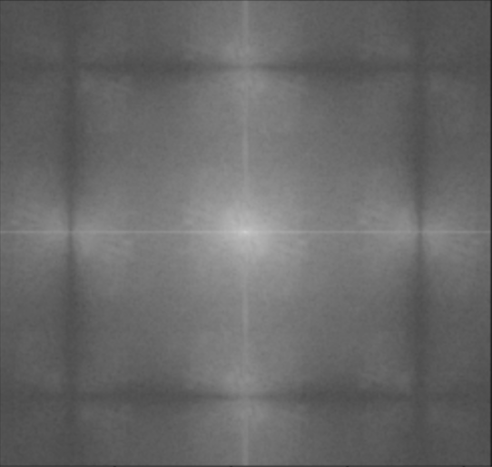
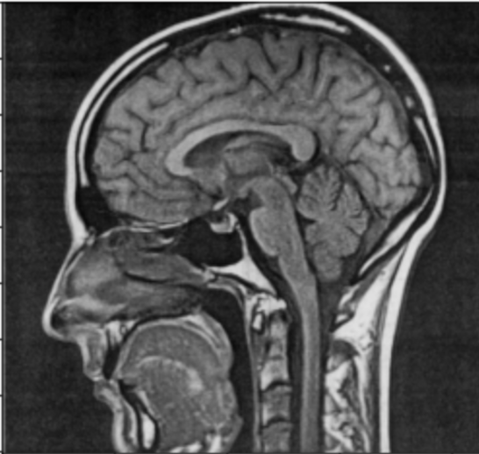
Super-resolution reconstruction
The acquisition of MRI is slow
The MRI acquisition is performed in k-space in a sequential manner
K-space
Signal space
Inverse Fourier Transform
Notes:
As we can see, the real slow part is traversing the K-space

Slide 4

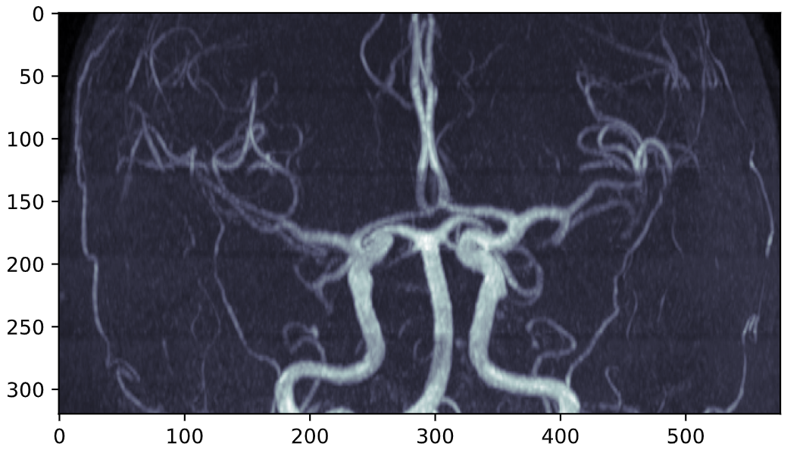

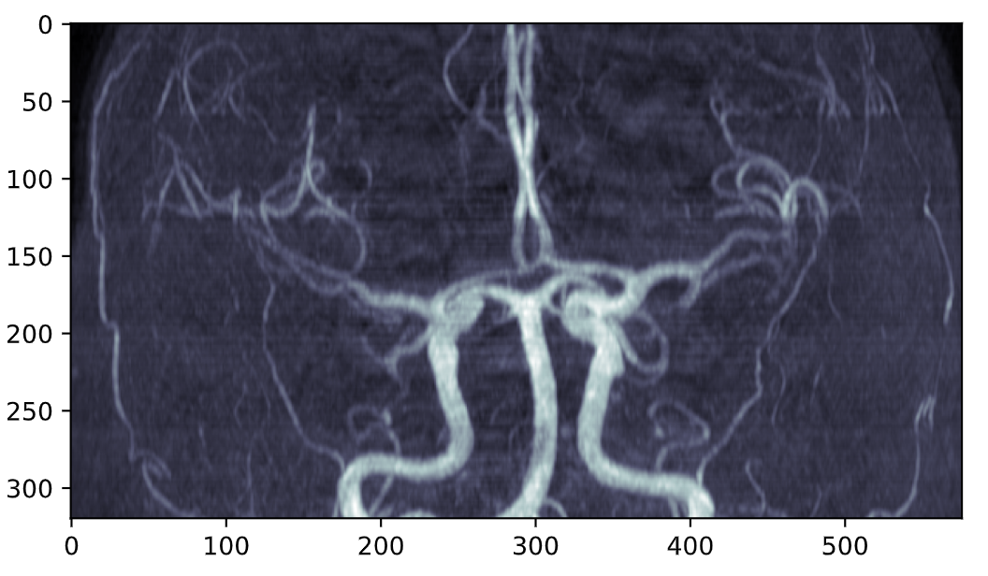

Undersampling
100% sampling
Super-resolution
Reconstruction
25% sampling
4 fold acceleration
Notes:
Ignore part of k-space
Due to the violation of the Nyquist sampling theorem, there would be some artifacts

Slide 5
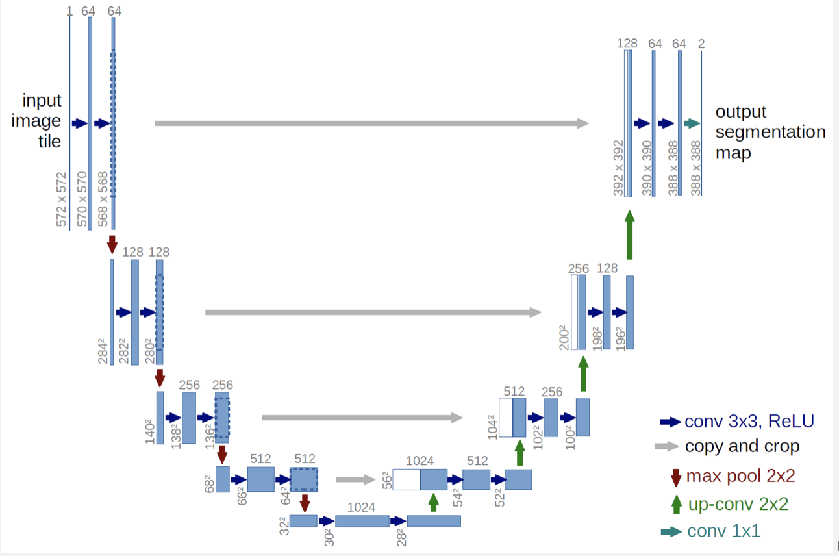
U-Net Architecture
O. Ronneberger and P.Fischer and T. Brox U-Net: Convolutional Networks for Biomedical Image Segmentation, Medical Image Computing and Computer-Assisted Intervention (MICCAI), Springer, LNCS, Vol.9351: 234--241, 2015
Notes:
The data progate through all possible path of the neural netword. At the

Slide 6

Convolutional layer
A Comprehensive Guide to Convolutional Neural Networks — the ELI5 way, https://towardsdatascience.com/a-comprehensive-guide-to-convolutional-neural-networks-the-eli5-way-3bd2b1164a53

Slide 7
U-Net Architecture
O. Ronneberger and P.Fischer and T. Brox U-Net: Convolutional Networks for Biomedical Image Segmentation, Medical Image Computing and Computer-Assisted Intervention (MICCAI), Springer, LNCS, Vol.9351: 234--241, 2015
Notes:
The data progate through all possible path of the neural netword. At the

Slide 8
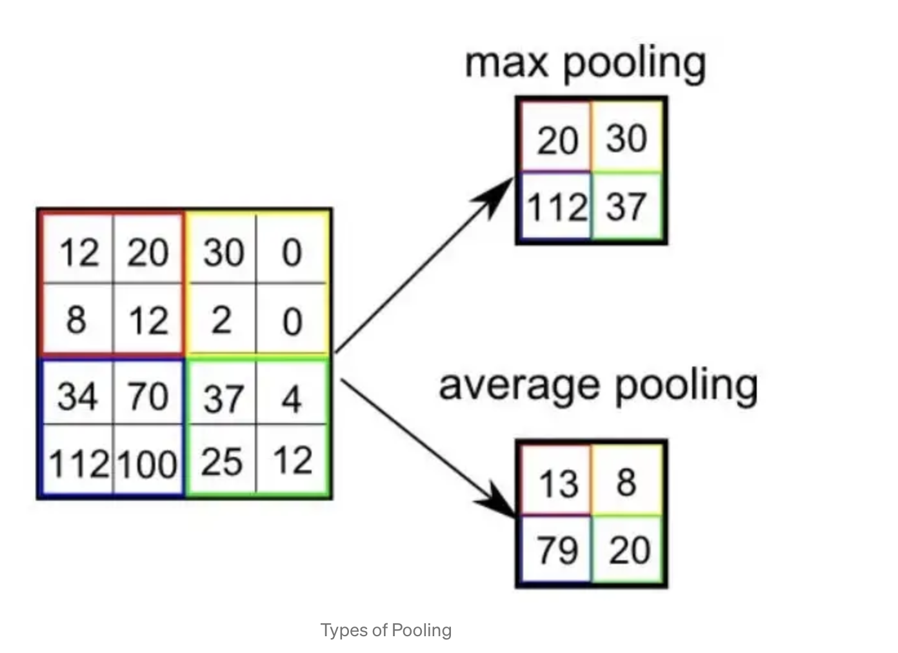
Max Pooling layer
A Comprehensive Guide to Convolutional Neural Networks — the ELI5 way, https://towardsdatascience.com/a-comprehensive-guide-to-convolutional-neural-networks-the-eli5-way-3bd2b1164a53

Slide 9
U-Net Architecture
Expansion
Contraction
O. Ronneberger and P.Fischer and T. Brox U-Net: Convolutional Networks for Biomedical Image Segmentation, Medical Image Computing and Computer-Assisted Intervention (MICCAI), Springer, LNCS, Vol.9351: 234--241, 2015
Notes:
The data progate through all possible path of the neural netword. At the

Slide 10
Up-convolution layer
Stride (2*2)
Output (4*4)
Input (2*2)
Kernel (1*1)
2 | 0 | 3 | 0
0 | 0 | 0 | 0
1 | 0 | 4 | 0
0 | 0 | 0 | 0
2 | 3
1 | 4
1
A Comprehensive Guide to Convolutional Neural Networks — the ELI5 way, https://towardsdatascience.com/a-comprehensive-guide-to-convolutional-neural-networks-the-eli5-way-3bd2b1164a53

Slide 11
U-Net Architecture
O. Ronneberger and P.Fischer and T. Brox U-Net: Convolutional Networks for Biomedical Image Segmentation, Medical Image Computing and Computer-Assisted Intervention (MICCAI), Springer, LNCS, Vol.9351: 234--241, 2015
Notes:
The data progate through all possible path of the neural netword. At the

Slide 12
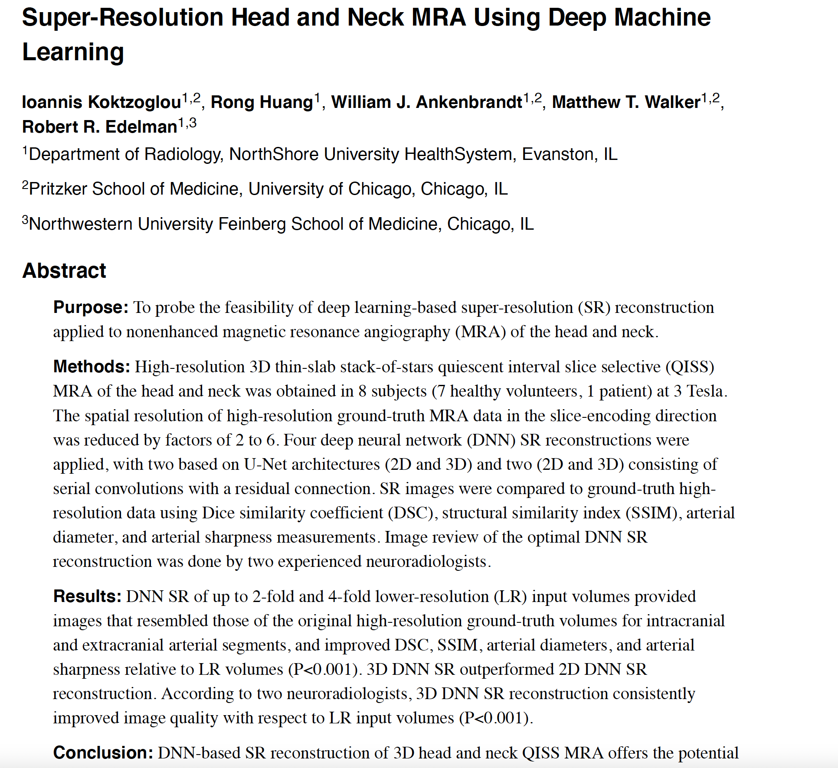
Replicate the result of this paper based our ARIC dataset

Slide 13
Parameters used in training
parameters | size
Image patch | 32*32
Image stride | 4*4
Crop percentage | 0.9
Num of downsampling layer | 4
Num of upsampling layer | 4
Learning rate | 0.001
optimizer | Adam
dropout | 0.5

Slide 14
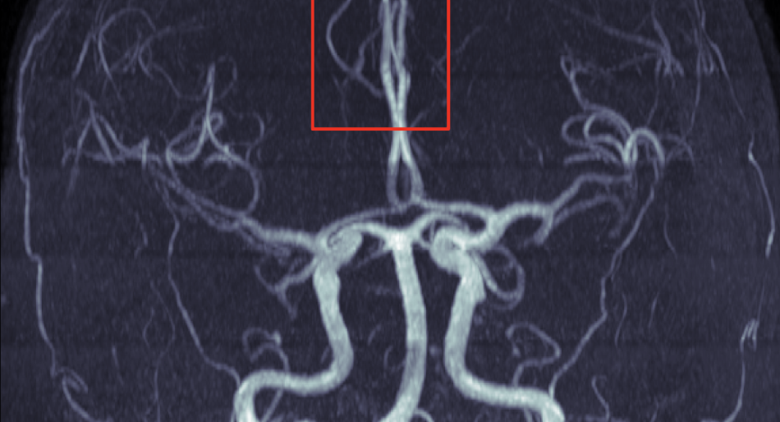
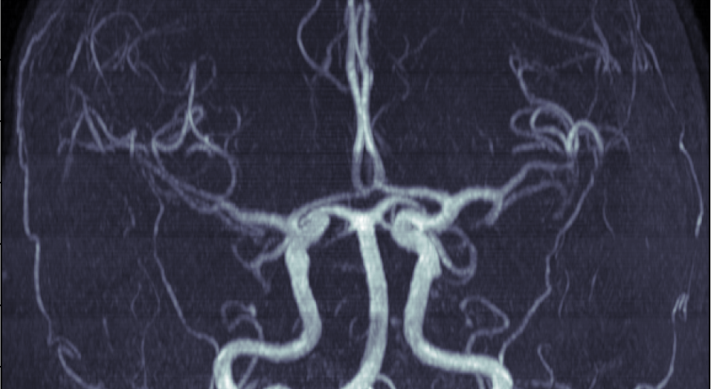
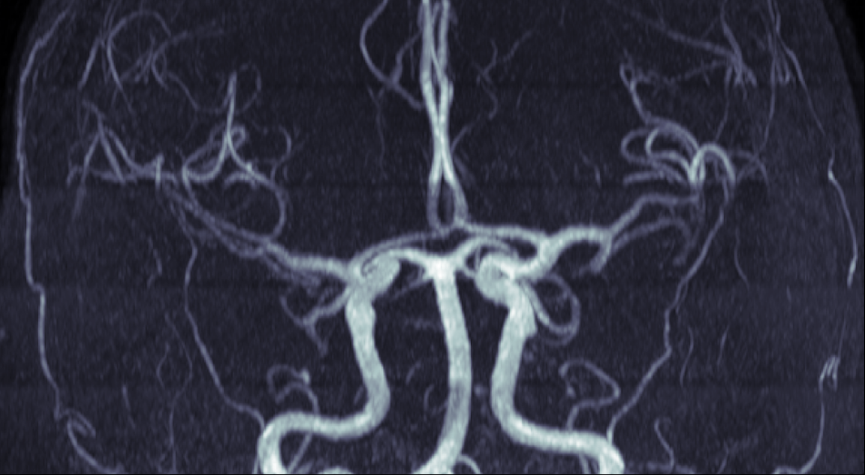
Result – 2fold
Ground Truth
Low resolution
reconstruction

Slide 15
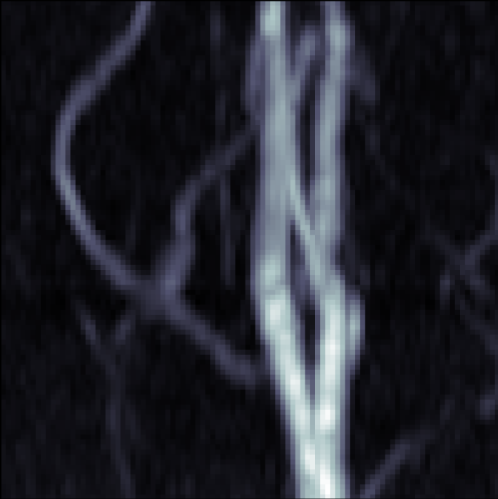
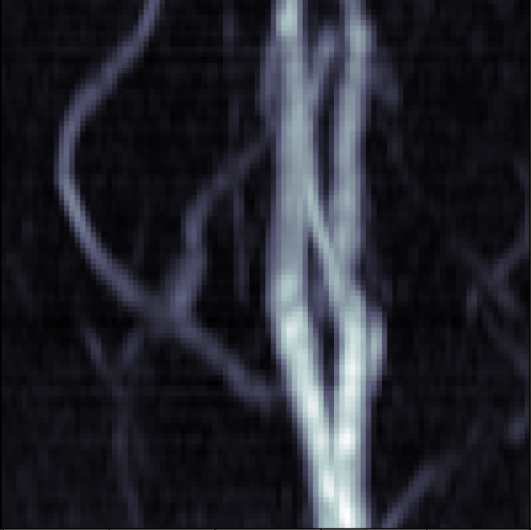
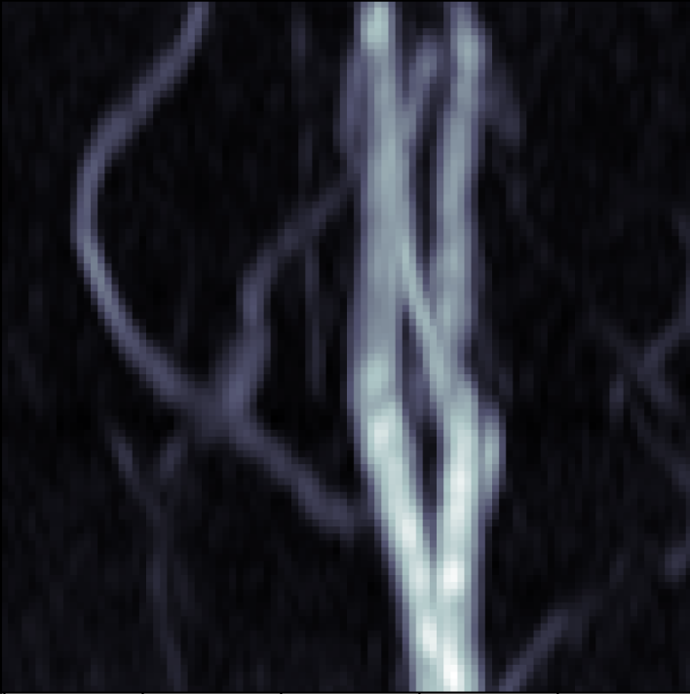
2fold
Ground Truth
Low resolution
reconstruction
Low resolution

Slide 16
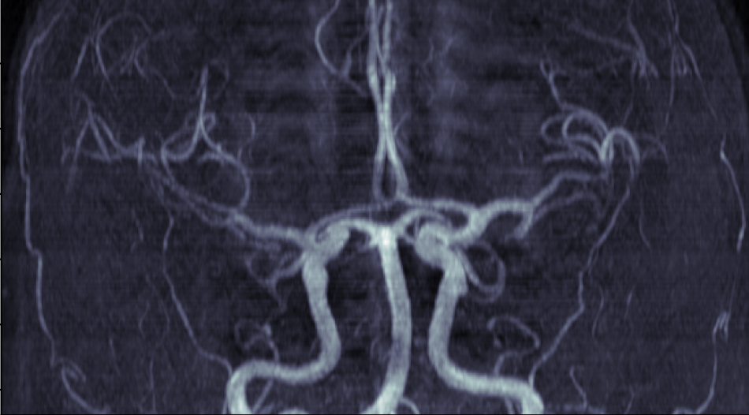
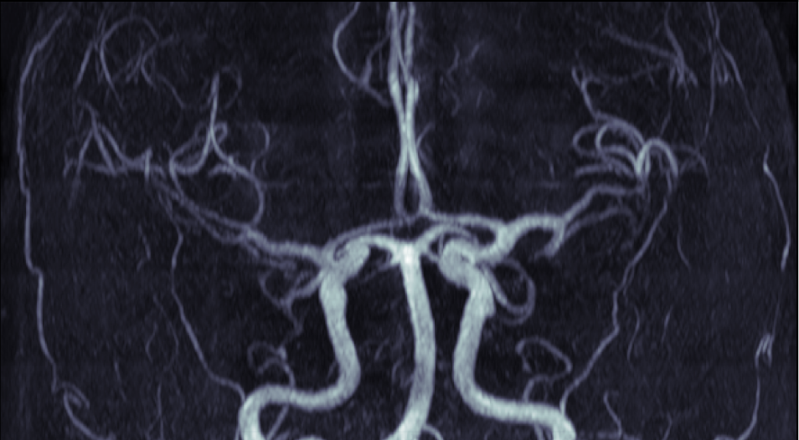
Result – 3fold
Ground Truth
Low resolution
reconstruction

Slide 17
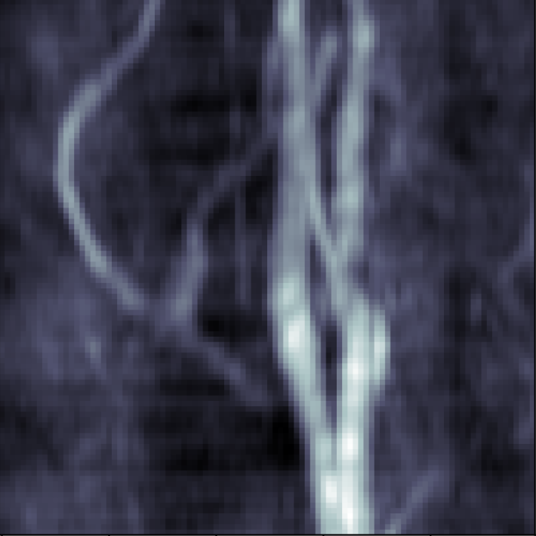
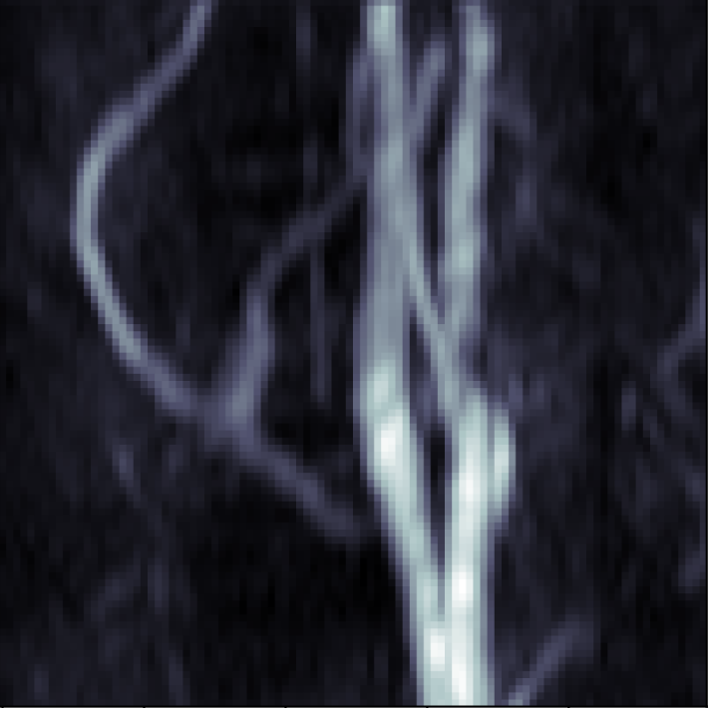
3fold
Ground Truth
Low resolution
reconstruction
Low resolution

Slide 18
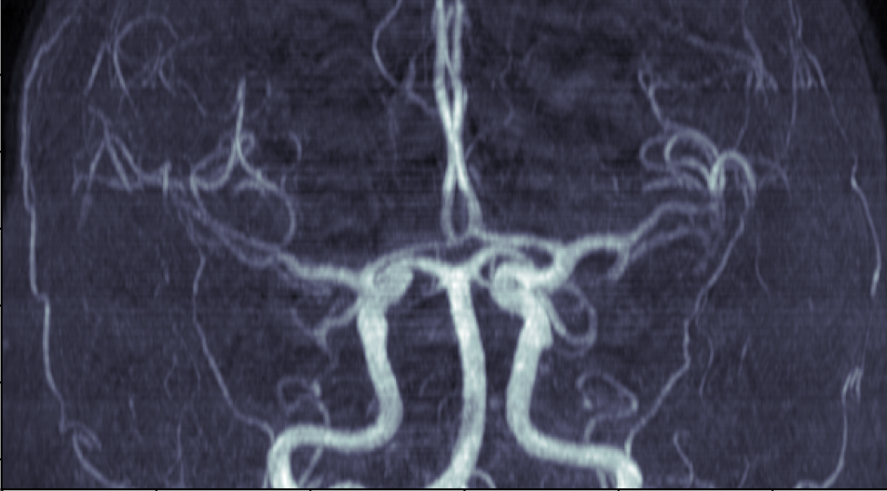
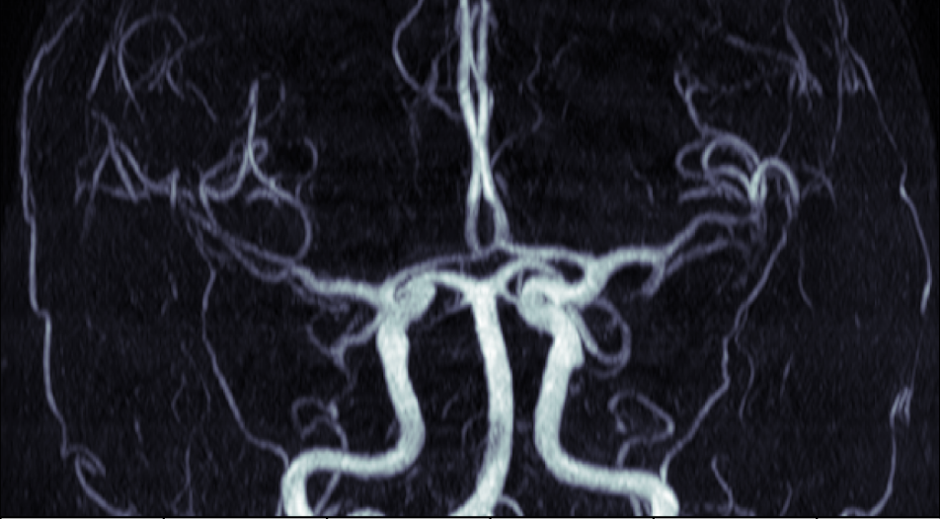
Result – 4fold
Ground Truth
Low resolution
reconstruction

Slide 19
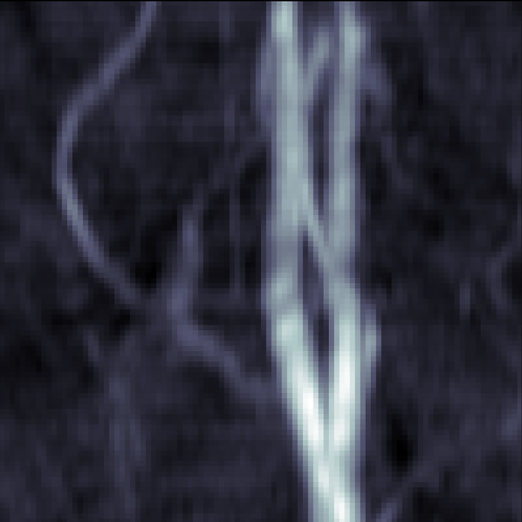
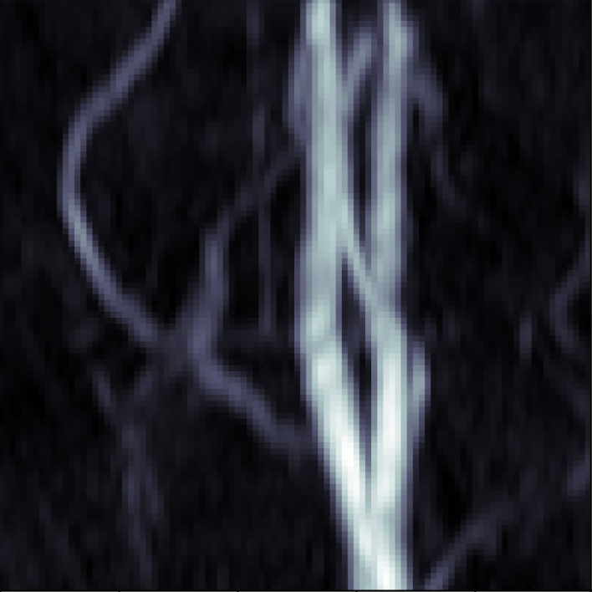
4fold
Ground Truth
Low resolution
reconstruction
Low resolution

Slide 20
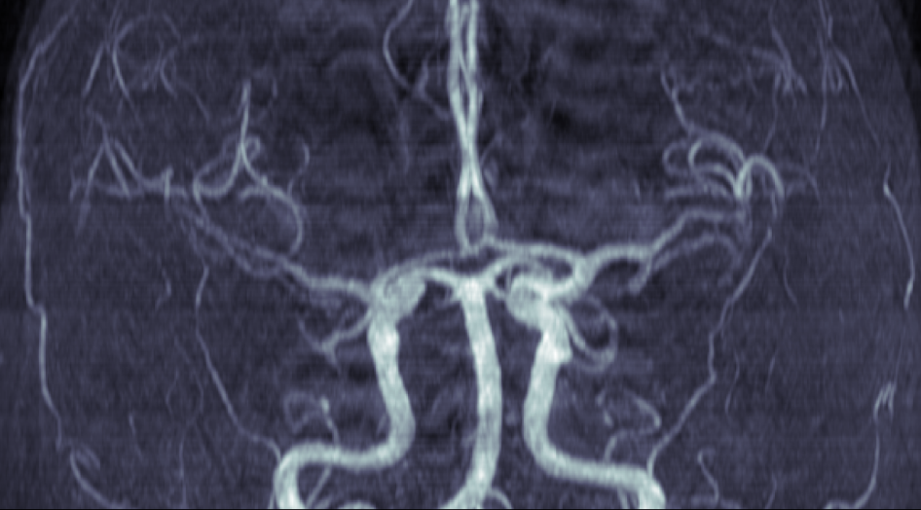
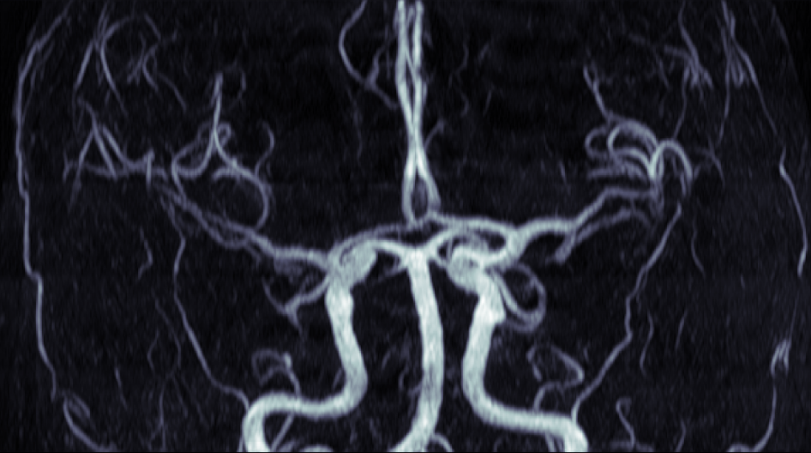
Result – 5fold
Ground Truth
Low resolution
reconstruction

Slide 21
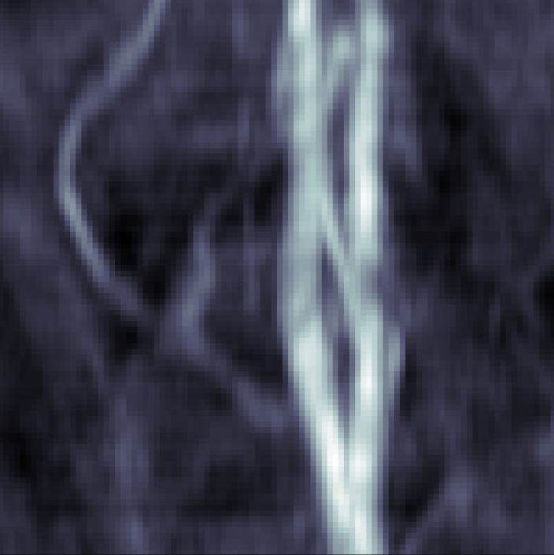
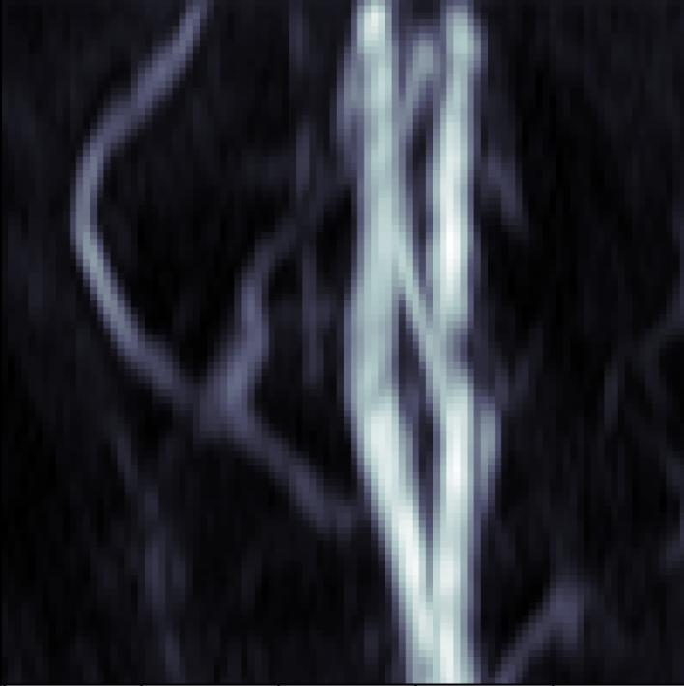
5fold
Ground Truth
Low resolution
Low resolution
reconstruction

Slide 22
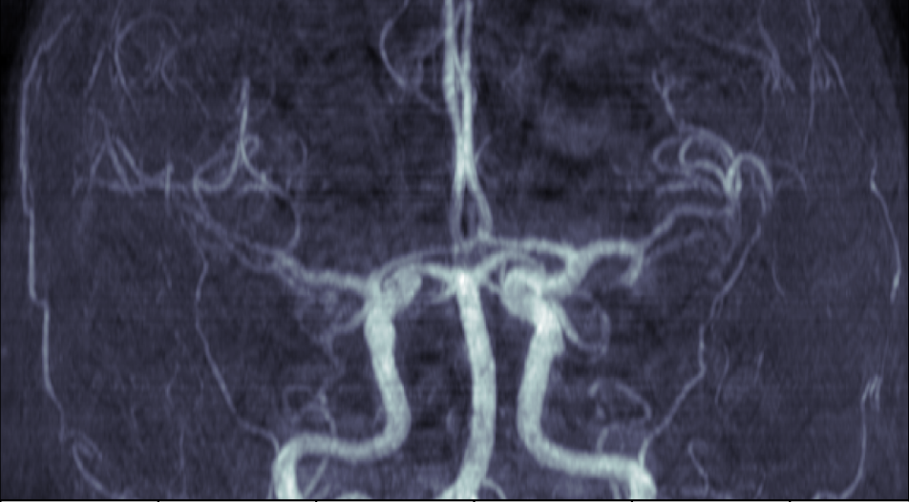
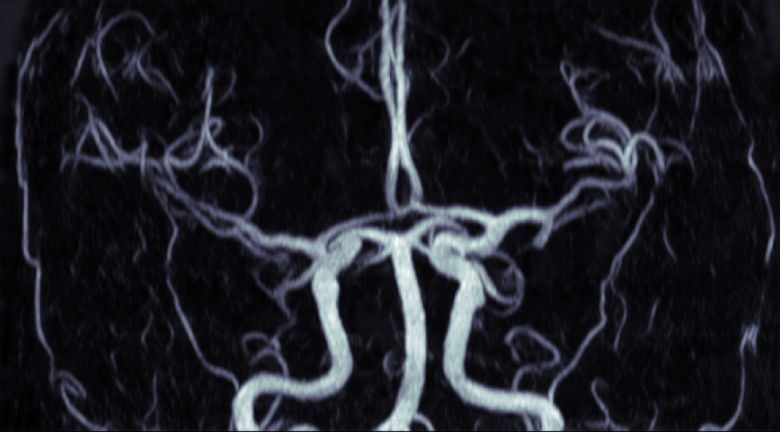
Result – 6fold
Ground Truth
Low resolution
reconstruction

Slide 23
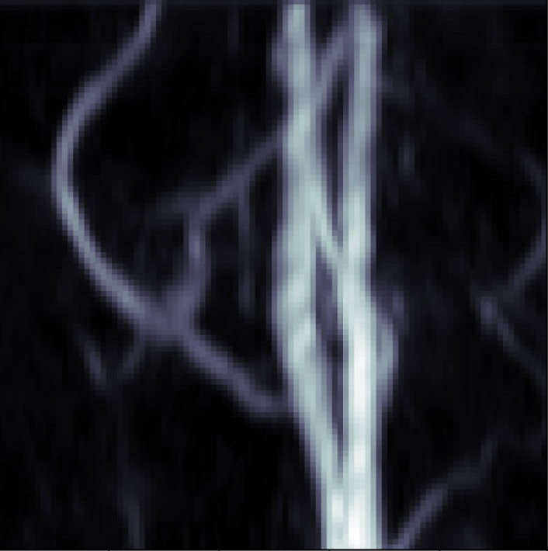
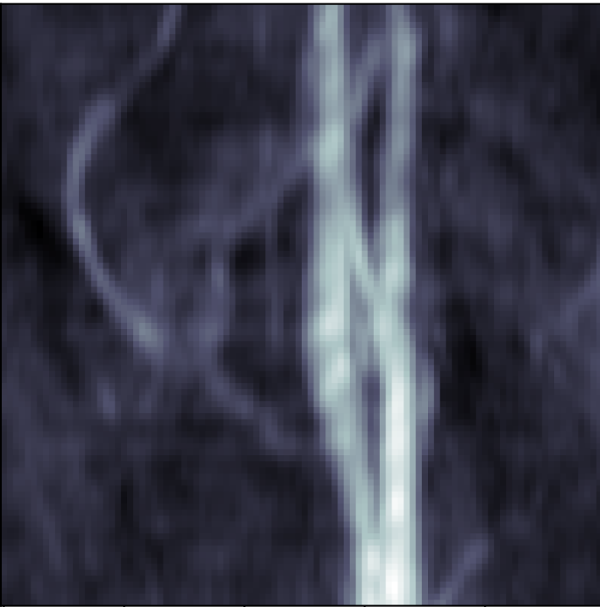
6fold
Ground Truth
Low resolution
reconstruction
Low resolution

Slide 24
Thank you

Slide 25
Thank you

Slide 26
Data: ground truth: ARIC/scans/6_TOF_3D_5-slab_MIP_COR/NII
Low resolution image are generated by code/MRUnder-master/main.py. There are 2,3,4,5,6 fold
These images are 2D images

